Slide 1
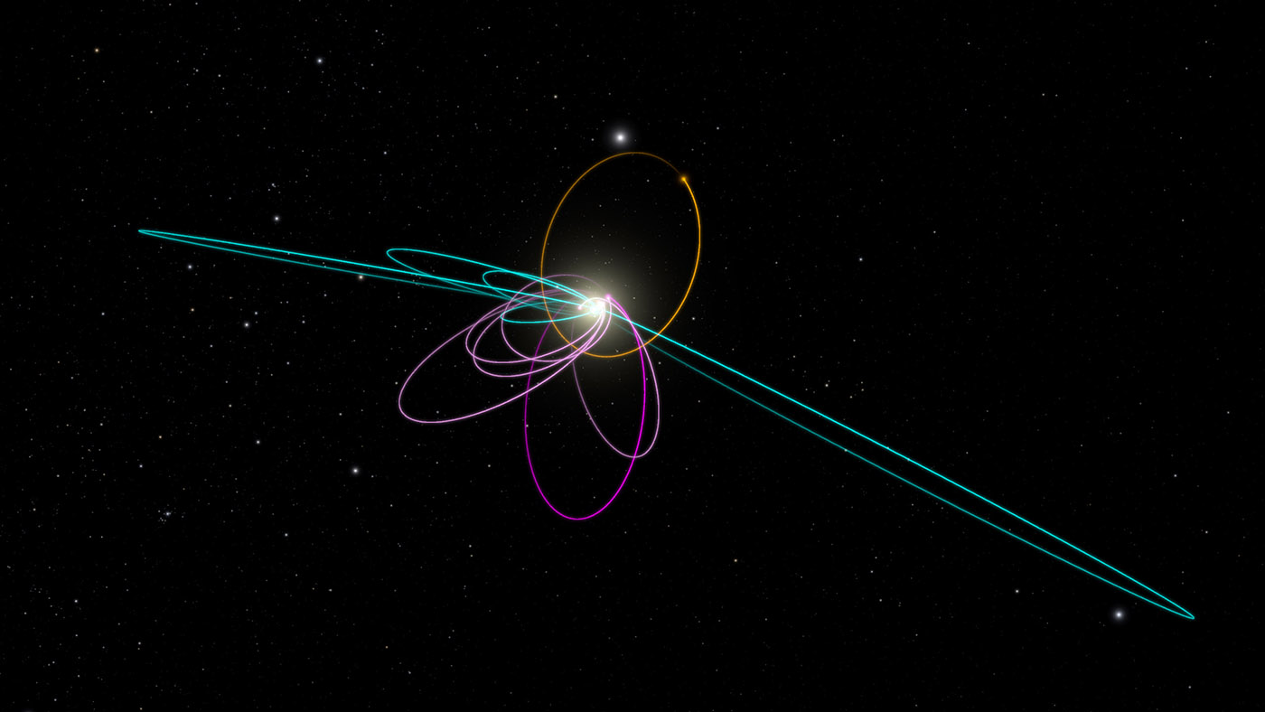
Julia Language 1.0 Ephemeris and Physical Constants Reader for Solar System Bodies
Gravitational Modeling
Renee Spear
Embry-Riddle Aeronautical University
Aerospace Engineering Department
https://solarsystem.nasa.gov/images/galleries/p9_kbo_extras_orbits_2_1400.jpg
Notes:
https://solarsystem.nasa.gov/images/galleries/p9_kbo_extras_orbits_2_1400.jpg

Slide 2
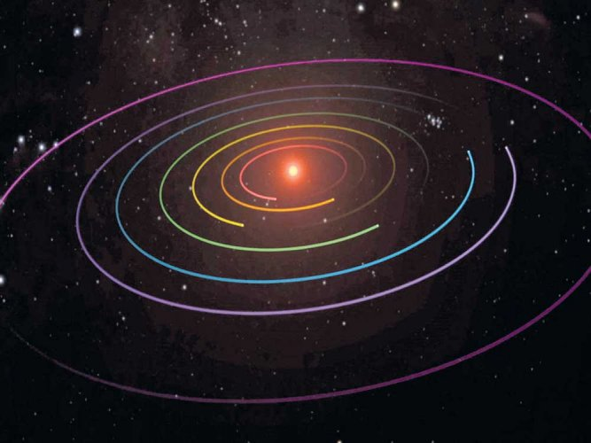
Acknowledgements
Dr. Damon Landau
Dr. Kaela Martin
Julia Mihaylov
Courtesy of NASA.
Courtesy of NASA.

Slide 3
What is Julia?
Julia
FORTRAN
C
Dynamic
MATLAB
Python
Static
Notes:
Julia was publicly released in 2012 and is a combination of static languages, such as Fortran and C, and dynamic languages, such as Matlab and Python. With this combination, Julia has a high computational efficiency and performance level (due to its static language components) while still providing an interactive and productive behavior (from its dynamic language parts).

Slide 4
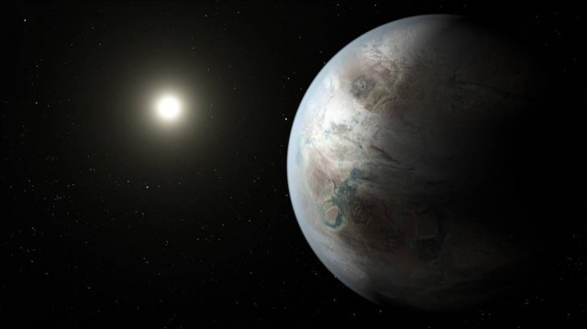
Why Use Boddat?
Retrieve updated ephemeris information
Simplify and aid future space missions
Improve available Julia Language library within NASA
Trajectory optimization
Satellite navigation
Spacecraft telemetry
Courtesy of NASA.
Notes:
Original code in MATLAB
Major and small body characteristics
Lagrange points
Higher order spherical harmonics
Asteroid shape modeling

Slide 5
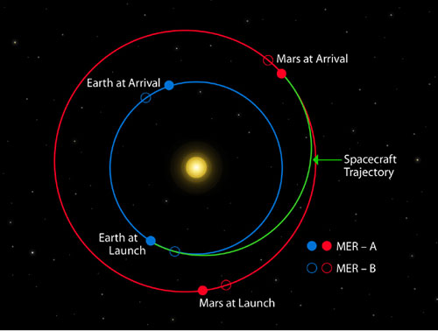
Why Use Boddat?
Position of Earth and Mars at both launch and arrival of each rover.
Image Credit: NASA
Notes:
Give general overview of how the functions work/why they are necessary and that they take inputs and give outputs (describe inputs/outputs in terms of the diagram on the slide)

Slide 6
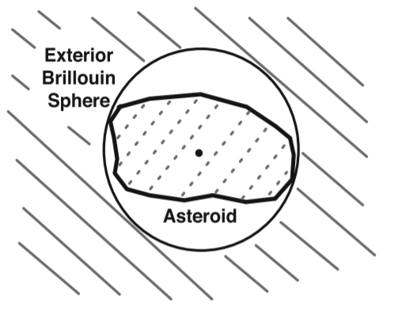
gravmod
Gravitational potential of a body on a spacecraft
65 bodies available for modeling
Utilizes exterior gravitational field modeled using a Brillouin sphere
5 sub-functions
Courtesy of Springer Science.
Notes:
17 asteroids
48 major bodies and moons

Slide 7
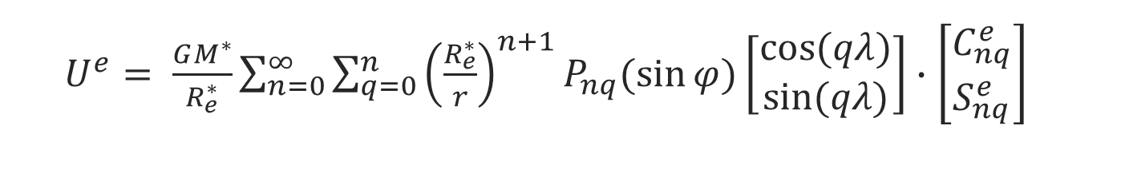
Exterior Gravity Field
$U^{e}= \frac{GM^{∗}}{R_{e}^{∗}}\sum_{n=0}^{∞}{\sum_{q=0}^{n}{{\left(\frac{R_{e}^{∗}}{r}\right)}^{n+1}}P_{nq}(\sin{φ})\left[\begin{matrix}\cos{(qλ)} \\ \sin{(qλ)}\end{matrix}\right]∙\left[\begin{matrix}C_{nq}^{e} \\ S_{nq}^{e}\end{matrix}\right]}$
Symbol | Meaning
U^{e} | Potential
G | Gravitational constant
M* | Reference mass of the body
R*_{e} | Reference radius of the body
r | Spacecraft position
P_{nq} | Associated Legendre function
Ce_{nq}, S^{e}_{nq} | Spherical harmonic coefficients
λ, φ | Longitude, latitude of spacecraft in body-fixed frame
Notes:
17 asteroids
48 major bodies and moons
Associated Legendre function of degree n and order q

Slide 8
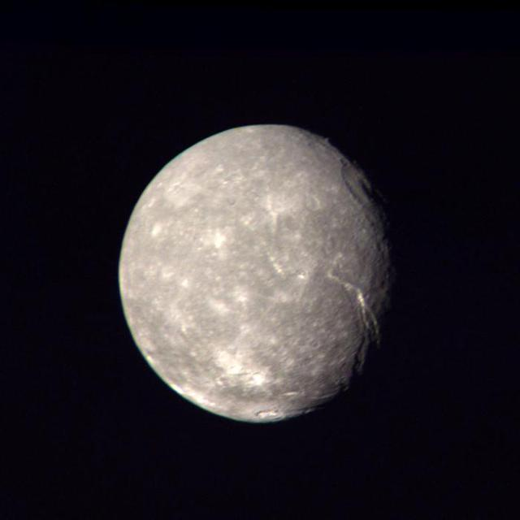
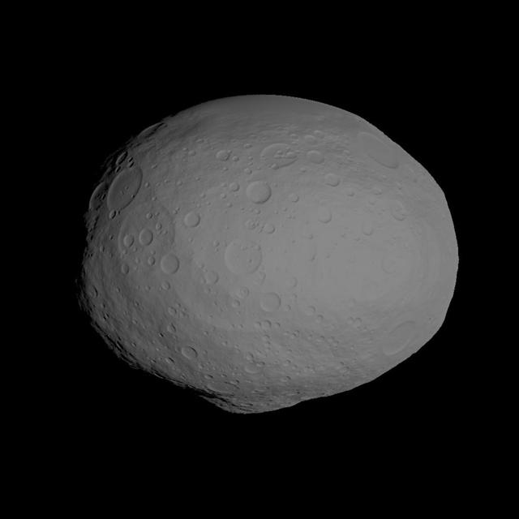
Applied Mathematics
sphereMassMod function
ellMassMod function
haversine function
Prime meridian direction cosine matrix (pmdcm)
Courtesy of NASA.
Courtesy of NASA.

Slide 9
How to Use gravmod
  potentialB = gravmod([“body”], [scPos], [t])
Parameter | Meaning
body | Desired body for gravitational potential
scPos | Spacecraft position wrt Sun [km]
t | Days past noon in Barycentric Dynamical Time (TDB) on January 1, 2000 (J2000) for orientation
Notes:
Julia works like Python in that additional libraries must be loaded for additional features
Questions:
JLD – allows Julia to save variables in a format similar to .mat in MATLAB
HDF5 - Hierarchical Data Format 5 , managing data collections of all sizes and complexity.

Slide 10
gravmod Spheroid Model Example
potentialB = gravmod([“Earth”], [-1.5*10^7, 1.5*10^8,
-7.0*10^3])
Input | Meaning
“Earth” | Desired body for gravitational potential
[-1.5*10^7, 1.5*10^8, -7.0*10^3] | Spacecraft position wrt Sun [km]
Notes:
Dict – Julia doesn’t have persistent storage variables, dict used as a workspace for the function
Allows he code save variables of different sizes and types into one structure
This one is just a placeholder but the code runs faster if a dictionary variable is specified
TDB – Barycentric dynamical time

Slide 11
gravmod Spheroid Model Example
Input: potentialB = gravmod([“Earth”],
[-1.5*10^7, 1.5*10^8, -7.0*10^3])
Output: 6.91*10^8
Output | Meaning
6.91*10^8 | Potential of the body on the spacecraft at that location [kJ/kg]
Notes:
Sun centered ecliptic frame - Inertial sun ecliptic reference frame

Slide 12
gravmod Ellipsoid Model Example
potentialB = gravmod([“Ceres”], [-2.96*10^8,
-2.12*10^8, 0.74*10^8])
Input | Meaning
[“Ceres”] | Desired body for gravitational potential
[-2.96*10^8, -2.12*10^8, 0.74*10^8] | Spacecraft position wrt Sun [km]
Notes:
Dict – Julia doesn’t have persistent storage variables, dict used as a workspace for the function
Allows he code save variables of different sizes and types into one structure
This one is just a placeholder but the code runs faster if a dictionary variable is specified
TDB – Barycentric dynamical time

Slide 13
gravmod Ellipsoid Model Example
Input: potentialB = gravmod([“Ceres”], [-2.96*10^8, 2.12*10^8, 0.74*10^8])
Output: 1.93*10^-12
Output | Meaning
1.93*10^-12 | Gravitational potential of the body on the spacecraft at that location [kJ/kg]
Notes:
Sun centered ecliptic frame - Inertial sun ecliptic reference frame

Slide 14
gravmod Time Example
potentialB = gravmod([“Mars”], [2.12*10^8, 1.96*10^8,
-3.63*10^5], [2260.])
Input | Meaning
[“Mars”] | Desired body for gravitational potential
[2.12*10^8, 1.96*10^8, -3.63*10^5] | Spacecraft position wrt Sun [km]
[2260.] | Noon TDB March 10, 2006 (with respect to J2000)​
Notes:
Dict – Julia doesn’t have persistent storage variables, dict used as a workspace for the function
Allows he code save variables of different sizes and types into one structure
This one is just a placeholder but the code runs faster if a dictionary variable is specified
TDB – Barycentric dynamical time

Slide 15
gravmod Time Example
Input: potentialB = gravmod([“Mars”],
[2.12*10^8, 1.96*10^8, -3.63*10^5], [2260.])
Output: 1.12*10^-8
Output | Meaning
1.12*10^-8 | Potential of the body on the spacecraft at that location [kJ/kg]
Notes:
Sun centered ecliptic frame - Inertial sun ecliptic reference frame

Slide 16
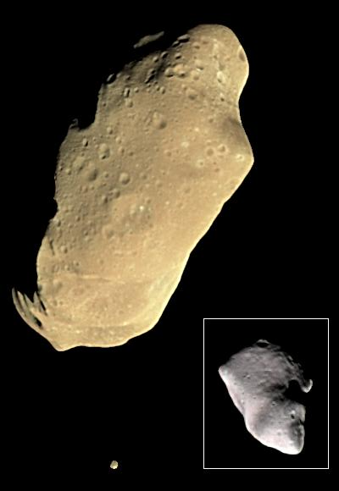
Future Implementations
Function for albedo
Increase optimization
Exterior gravity field design
Interior gravity field design
Courtesy of NASA.
Notes:
The first-generation of the ephemeris reader was designed with the ability to calculate characteristics of major and small bodies at user-defined times and find Lagrange points of user-defined bodies using Julia 0.6.⁶. The goal of the code is to create a computationally efficient, flexible, and multifunctional tool that will be used in mission design and Julia Language implementation within NASA

Slide 17
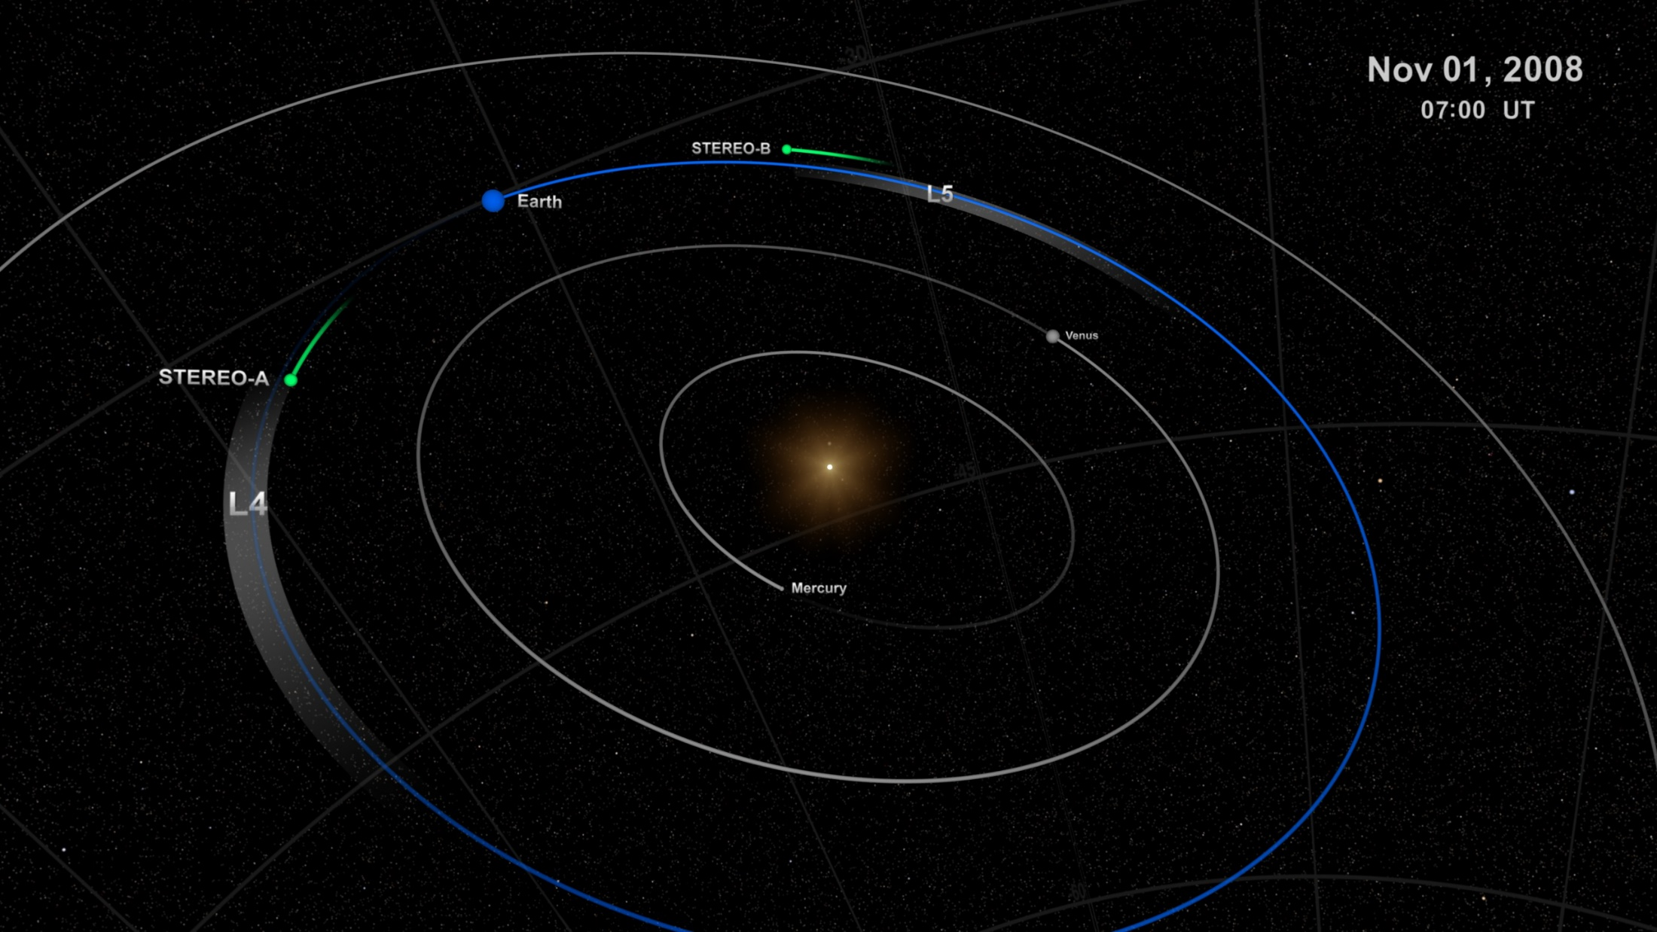
Questions?
Renee Spear
  spearr@my.erau.edu
Courtesy of NASA.

Slide 18
References
Bezanson, J., Edelman, A., Karpinski, S., and Shah, V. B., "Julia: A Fresh Approach to Numerical Computing," Soceity for Industrial and Applied Mathematics Review, Vol. 59, No. 1, 2015, pp. 65-98.
Englander, J. A. and Conway, B. A., "Automated Solution of Low-Thrust Interplanetary Trajectory Problem," Journal of Guidance, Control, and Dynamics, Vol. 40, No. 1, 2017, pp. 15-27.
Jiang, Y. Equilibrium Points and Orbits around Asteroid with the Full Gravitational Potential Caused by the 3D Irregular, Cornell University Library, 2018.
Reimond, S. and Baur, O., "Spheroidal and ellipsoidal harmonic expansions of the gravitational potential of Small Solar System Bodies. Case study: 67P/Churyumov-Gerasimenko," Journal of Geophysical Research, Vol. 121, No. 3, 2016.
Marson, R., Lagrasta, S., and Malvolti, F. "Computation of Precision Ephemeris coefficients in the GNSS message: Practical results from a proficient algorithm," IEEE AESS European Conference on Satellite Telecommunications, Rome, Italy, 2012.
Martin, K., Mihaylov, J., Spear, R., and Landau, D. "Julia Language Ephemeris and Physical Constants Reader for Solar System Bodies," AIAA Space Flight Mechanics Meeting, Kissimmee, FL, 2018.
Werner, R. and Scheeres, D., "Exterior gravitation of a polyhedron derived and compared with harmonic and mascon gravitation representations of asteroid 4769 Castalia," Celestial Mechanics and Dynamical Astronomy, Vol. 65, No. 3, pp. 313-344.
Takahashi, Y. and Scheeres, D., "Small body surface gravity fields via spherical harmonic expansions," Celestial Mechanics and Dynamical Astronomy, Vol. 119, No. 2, 2014.

Slide 19
References (cont.)
Aoki, S., Kinoshita, H., Guinot, B., Kaplan, G. H., and McCarthy, D. D. . S. P. K., "The New Definition of Universal Time," Astronomy and Astrophysics, 1982, pp. 359-361.
Chobotov, V. A. Orbital Mechanics, American Institute of Aeronautics and Astronautics, Reston, 2002.
Holdaway, R. "Satellite ephemeris prediction and orbit maneuverability by low thrust," 11th Electric Propulsion Conference, 1975.
Stoneking, E. T., Neerav, S., and Dean, C. J. "Real-Time Visualization of Spacecraft Telemetry for the GLAST and LRO Missions," SpaceOps Conference, Huntsville, AL, 2010.
Vasile, M., Ceriotti, M., Becerra, V. M., and Nasuto, S. J., "An Incremental Algorithm for the Optimization of Multiple Gravity Assist Trajectories," Computational Intelligence in Aerospace Sciences, 2014, pp. 745-779.

